Slide 1
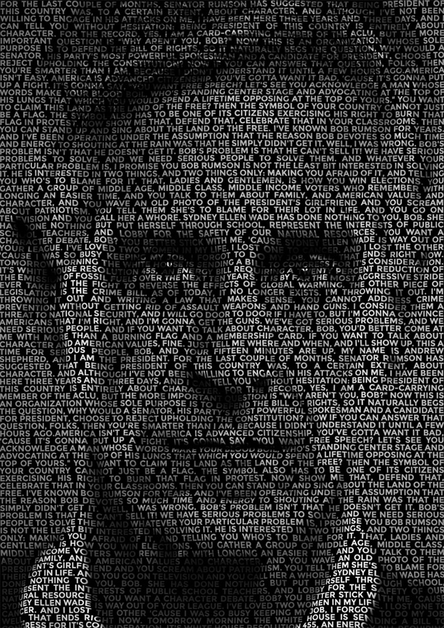
IMAGE CAPTIONING USING A CNN AND A TRANSFORMER
Group #4, CDS B4
10-Apr-2023
Version 0.01

Slide 2
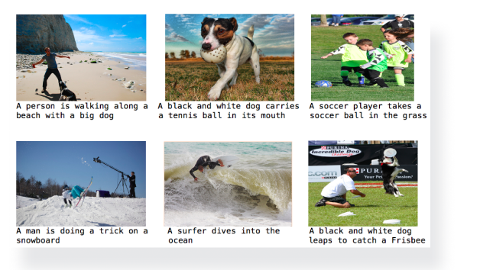
IMAGE CAPTIONING USING A CNN AND A TRANSFORMER
Agenda
Team
Introduction
Image Captioning
Market Size
Tools
Demo
Streamlit Demo
ML Flow
Top Level ML Pipeline
EDA
Model Pipeline
Performance Mwtric
Future Work

Slide 3


IMAGE CAPTIONING USING A CNN AND A TRANSFORMER
Members | Members
Hareeshwar Channapradga | Sandeep Gubbi
Karthick | Shivendu
Manjula T. | Sindhu P Satish
Manoranjan Sahu | Soumya
Parul K Sharma | Sridhar
Team Mentor : Sheshadri

Slide 4





IMAGE CAPTIONING USING A CNN AND A TRANSFORMER
ManoRanjan
MANJULA
PARUL K
SHIVENDU
SoumYA
SRIDHAR
Karthick

Slide 5

IMAGE CAPTIONING USING A CNN AND A TRANSFORMER
Introduction
Image captioning is about adding text sentences to images. It helps build context, narrative and story to images. It is helpful in situations where there are large number of images and it helps to automatically generate captions
Social Media Platforms
Image Captioning
Ecommerce
Security
Education
Healthcare

Slide 6
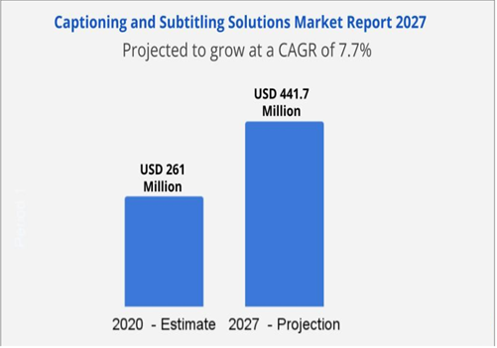
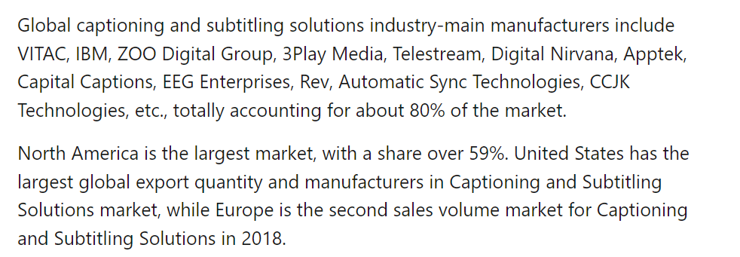
IMAGE CAPTIONING USING A CNN AND A TRANSFORMER
Market Size
Captioning and Subtitling Solutions Market Size, Growth, Industry Trends, Global Report 2021-2027 (linkedin.com)

Slide 7






IMAGE CAPTIONING USING A CNN AND A TRANSFORMER
Tools used
S. No. | Name | Description
1 | Flickr8 | 8,000 images from the Flickr website, 1,000 images from 8 different categories. Images are manually annotated with tags indicating category they belong to
2 | GloVe | comes in different sizes, trained on different text corpora, ranging from 6 billion tokens to over 840 billion tokens.
3 | Git Repo
Dataset
&
Project Repo

Slide 8

IMAGE CAPTIONING USING A CNN AND A TRANSFORMER
EDA
Data
Source
Size
Description
Images
Format
Count
Size
Color, pixel information
Captions
5 per image
Text size min max

Slide 9


IMAGE CAPTIONING USING A CNN AND A TRANSFORMER
EDA
Data Cleaning
Special characters in text
Non uniformity in image characteristics (sizes)
Data Statistics
Distribution of Data objects across categories
Data skew in image and text that impact training.

Slide 10

Top Level ML Pipeline
IMAGE CAPTIONING USING A CNN AND A TRANSFORMER
Flickr 8k
Feature Vector
(Image + Text)
Transformer with Attention
Image Inception V3
Text Berkely Glove
Bleu Score
Predicted Caption
Trained Model
New Image

Slide 11

IMAGE CAPTIONING USING A CNN AND A TRANSFORMER
Details of Algo with data
CNN vs Transformers vs Others.

Slide 12

IMAGE CAPTIONING USING A CNN AND A TRANSFORMER
Performance Metric
Tables with Number and meaning
Charts
Human readable caption outputs

Slide 13

IMAGE CAPTIONING USING A CNN AND A TRANSFORMER
Challenges & Future work
Challenges
GPU Training
Hyper parameter tuning
Future Work
Deployment (Mobile)
Real/Potential customers
Publication (Paper/Book/Patent)

Slide 14


IMAGE CAPTIONING USING A CNN AND A TRANSFORMER

Slide 15

IMAGE CAPTIONING USING A CNN AND A TRANSFORMER
Back up
Using Machine Learning to Generate Image Captions | by Nouman | Towards Data Science

